Slide 1
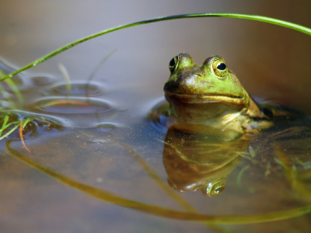
Ecosystems
Third Grade
Science

Slide 2
Objectives
Students will know that the Sun provides energy for the Earth in the form of heat and light.
Students will know that some source of energy is needed for organisms to stay alive and grow.
Student understands the various ways that animals depend on plants for survival.
Students will know that the size of a population is dependent upon the available resources within its community.

Slide 3
Vocabulary
Environment—is everything that surrounds a living thing. The nonliving parts of an environment support the living things in the environment.
Ecosystem—is all the living and nonliving things in an environment.

Slide 4
Vocabulary
Habitat—is the place where a living thing makes its home and meets its needs.
Population—is all the living things of the same kind that live in the same place at the same time.
Community—is all of the populations that live together in the same place.

Slide 5
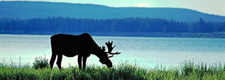
Environment
An environment includes plants, sun, water, animals, air, fungi, and trees.
Climate shapes the environment.
Water and soil are important parts of each environment
Notes:
*1) ask students which are living / non living
*2)What is climate?
Climate is the weather in a place all year.
*2)Why are different plants found in different climates?
specific plants are adapted to a specific type of weather
Ex: an environment that gets little rain will have different plants that
an area that gets a lot of rain
*3)Why are soil and water important?
each type of plant needs a certain amount of water and a certain kind of soil.

Slide 6
What is an Ecosystem?
An ecosystem is formed by the interactions between all living and non-living things.
A habitat has all the things that a plant or animal needs to live.
Notes:
*1) How do living and non-living things interact in an ecosystem?
living and nonliving things depend on each other for survival
*2)Give me an example of a habitat?l
What does _____ need to live?

Slide 7
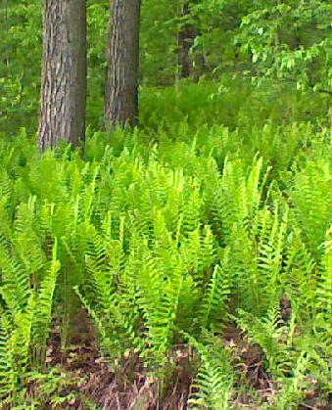
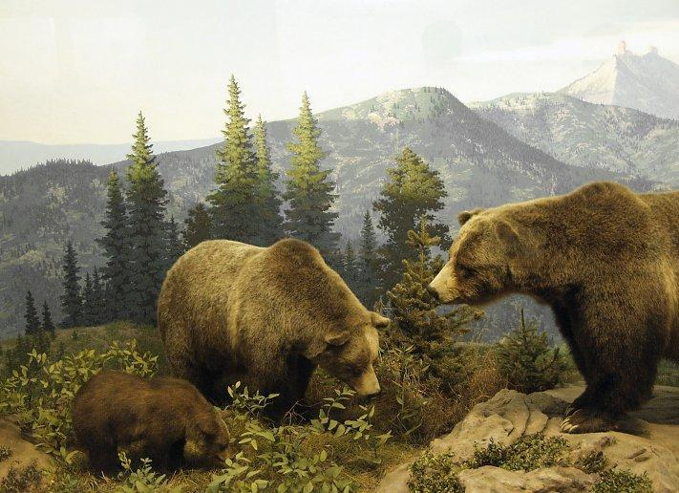
What is a population?
A population is one species living in a specific area.
For example, all bears or all ferns living in an area form a population.

Slide 8
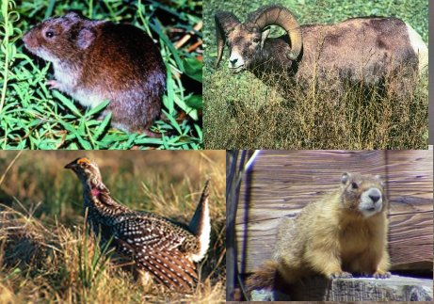
What is a community?
A community is formed from all living populations found in an area.

Slide 9
Non-living parts in your community
Buildings
Roads
Bodies of water
Automobiles
Traffic lights

Slide 10
How non-living and living things affect each other
Building more homes drives many animals out of their natural habitats or communities.
Littering can destroy an animals habitat.
Air pollution from automobiles and factories will affect the quality of life for all living things in a community, including people.

